Slide 1
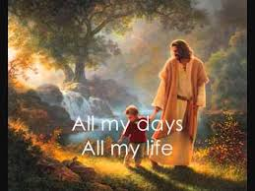
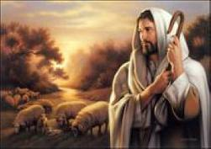
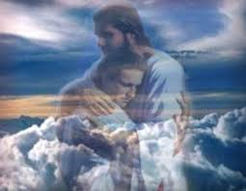
主你永遠與我同在
Lord You Are Always Here With Me

Slide 2
Lord You are always here with me
There is no changing God in Thee
主你永遠與我同在 在你裡面沒有改變

Slide 3
You are the same yesterday
and today and forever more
你的堅定 從昨日 到今日 一直到永遠

Slide 4
Here on Your promises I stand
You hold my future in your hand
靠你豐盛應許站立 我的未來在你手中

Slide 5
My solid rock, Almighty God I worship You
堅固磐石 全能真神 我敬拜你

Slide 6
When troubles come I trust in You
For I know You will lead me through
危難臨到, 我信靠你
深知你必領我渡過

Slide 7
And I know You are faithful till the end
你信實 為我堅持到最後

Slide 8
And when the storms are drawing near
When I’m with You I don’t have to fear
當暴風雨向我靠近
有你同在我不至畏懼

Slide 9
You’re my shepherd on whom I can depend
你是我的牧者 我所依靠

Slide 10
Through the day, through the night
I know You’re always by my side
每個夜 每一天
我知你永遠在身邊

Slide 11
Lord You are always here with me
There is no changing God in Thee
主你永遠與我同在 在你裡面沒有改變

Slide 12
You are the same yesterday
and today and forever more
你的堅定 從昨日 到今日 一直到永遠

Slide 13
Here on Your promises I stand
You hold my future in your hand
靠你豐盛應許站立 我的未來在你手中

Slide 14
My solid rock, Almighty God I worship You
堅固磐石 全能真神 我敬拜你

Slide 15
When troubles come I trust in You
For I know You will lead me through
危難臨到, 我信靠你
深知你必領我渡過

Slide 16
And I know You are faithful till the end
你信實 為我堅持到最後

Slide 17
And when the storms are drawing near
When I’m with You I don’t have to fear
當暴風雨向我靠近
有你同在我不至畏懼

Slide 18
You’re my shepherd on whom I can depend
你是我的牧者 我所依靠

Slide 19
Through the day, through the night
I know You’re always by my side
每個夜 每一天
我知你永遠在身邊

Slide 20
Lord You are always here with me
There is no changing God in Thee
主你永遠與我同在 在你裡面沒有改變

Slide 21
You are the same yesterday
and today and forever more
你的堅定 從昨日 到今日 一直到永遠

Slide 22
Here on Your promises I stand
You hold my future in your hand
靠你豐盛應許站立 我的未來在你手中

Slide 23
My solid rock, Almighty God I worship You
堅固磐石 全能真神 我敬拜你

Slide 24
Lord You are always here with me
There is no changing God in Thee
主你永遠與我同在 在你裡面沒有改變

Slide 25
You are the same yesterday
and today and forever more
你的堅定 從昨日 到今日 一直到永遠

Slide 26
Here on Your promises I stand
You hold my future in your hand
靠你豐盛應許站立 我的未來在你手中

Slide 27
My solid rock, Almighty God I worship You (2X)
堅固磐石 全能真神 我敬拜你

